Slide 1
What attributes influence the selection of a romantic partner?
PREDICT 422 - Section 56 - Group 2
Bruckner, Funk, Sheets, Zimmerman

Slide 2
Data
Sourced from Kaggle
Compiled by Columbia Business School professors Ray Fisman and Sheena Iyengar for their paper title “Gender Differences in Mate Selection: Evidence From a Speed Dating Experiment.”

Slide 3
Additional Data Info
Data was gathered from participants in experimental speed dating events from 2002-2004. During the events, the attendees would have a four minute "first date" with every other participant of the opposite sex. At the end of their four minutes, participants were asked if they would like to see their date again. They were also asked to rate their date on six attributes: Attractiveness, Sincerity, Intelligence, Fun, Ambition, and Shared Interests.
The dataset also includes questionnaire data gathered from participants at different points in the process. These fields include: demographics, dating habits, self-perception across key attributes, beliefs on what others find valuable in a mate, and lifestyle information. See the Speed Dating Data Key document below for details.

Slide 4
EDA - initial findings
There was not a single line of data that was “complete”.
Lots of missing data!
Noticed that for a majority of the follow up questions, the data was missing at a higher rate.
For simplicity’s sake, decided to focus on variables gathered through the pre-date survey.
Demographics, interests, attributes they find important.
Additionally, limited to only the waves that used the same preference scale (score from 1-100)
Performed listwise deletion instead of imputation to handle missing.
Data went from 8378 rows with 195 variables (sparsely populated) to 6521 rows with 51 variables (complete).

Slide 5
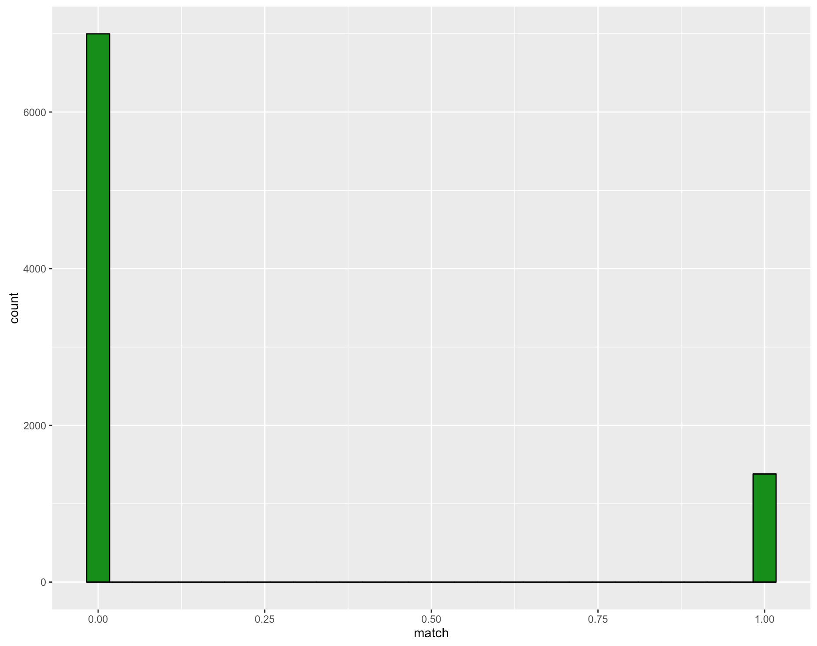
EDA - Response
Variable
Much fewer matches than non-matches.
As we’ll see in the end results, this greatly impacts our model’s ability to successfully predict whether a date will end in a match.
Classification problem

Slide 6
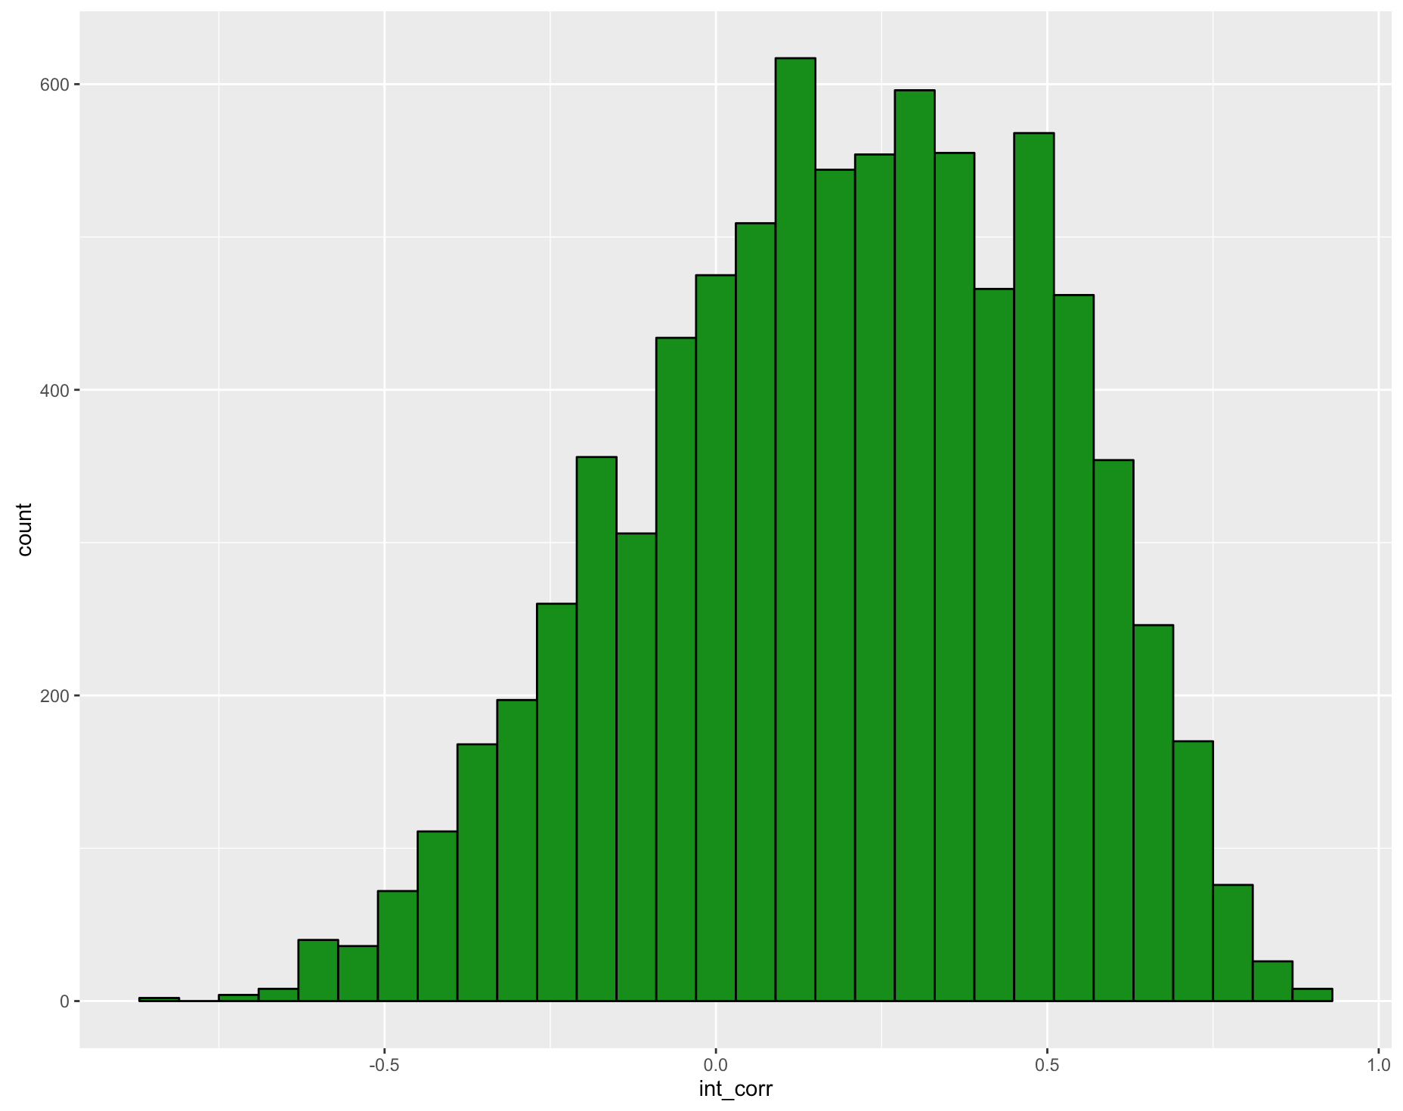
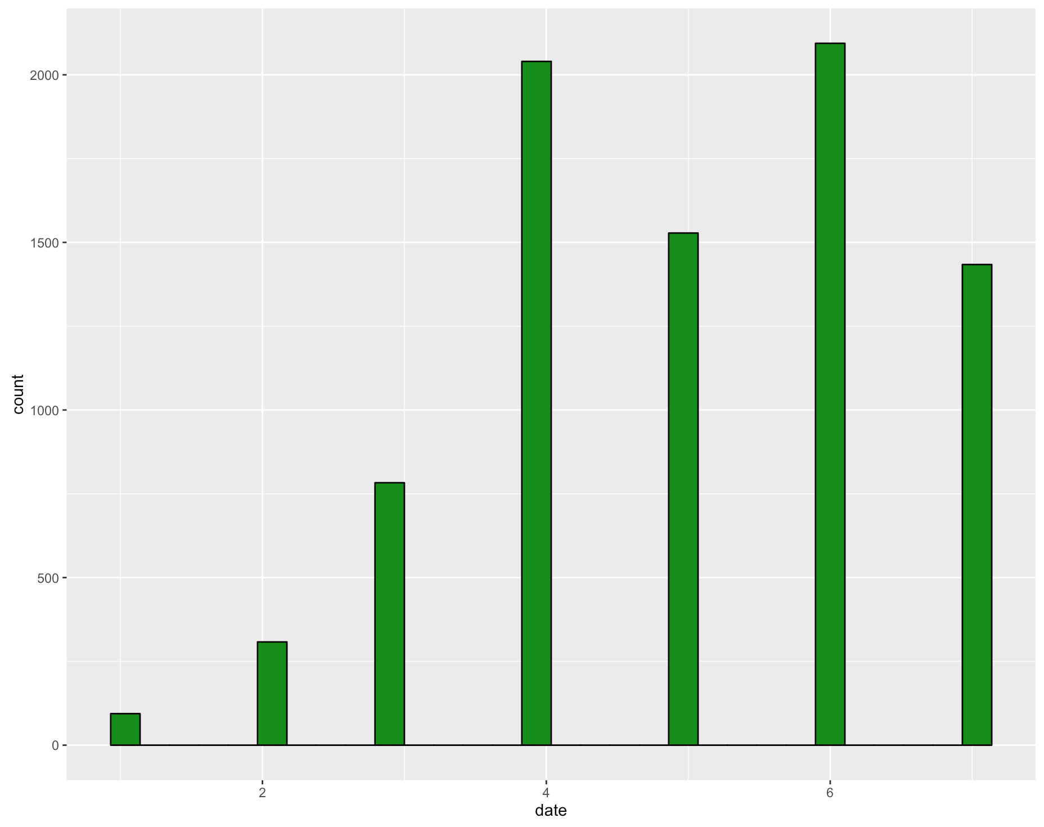
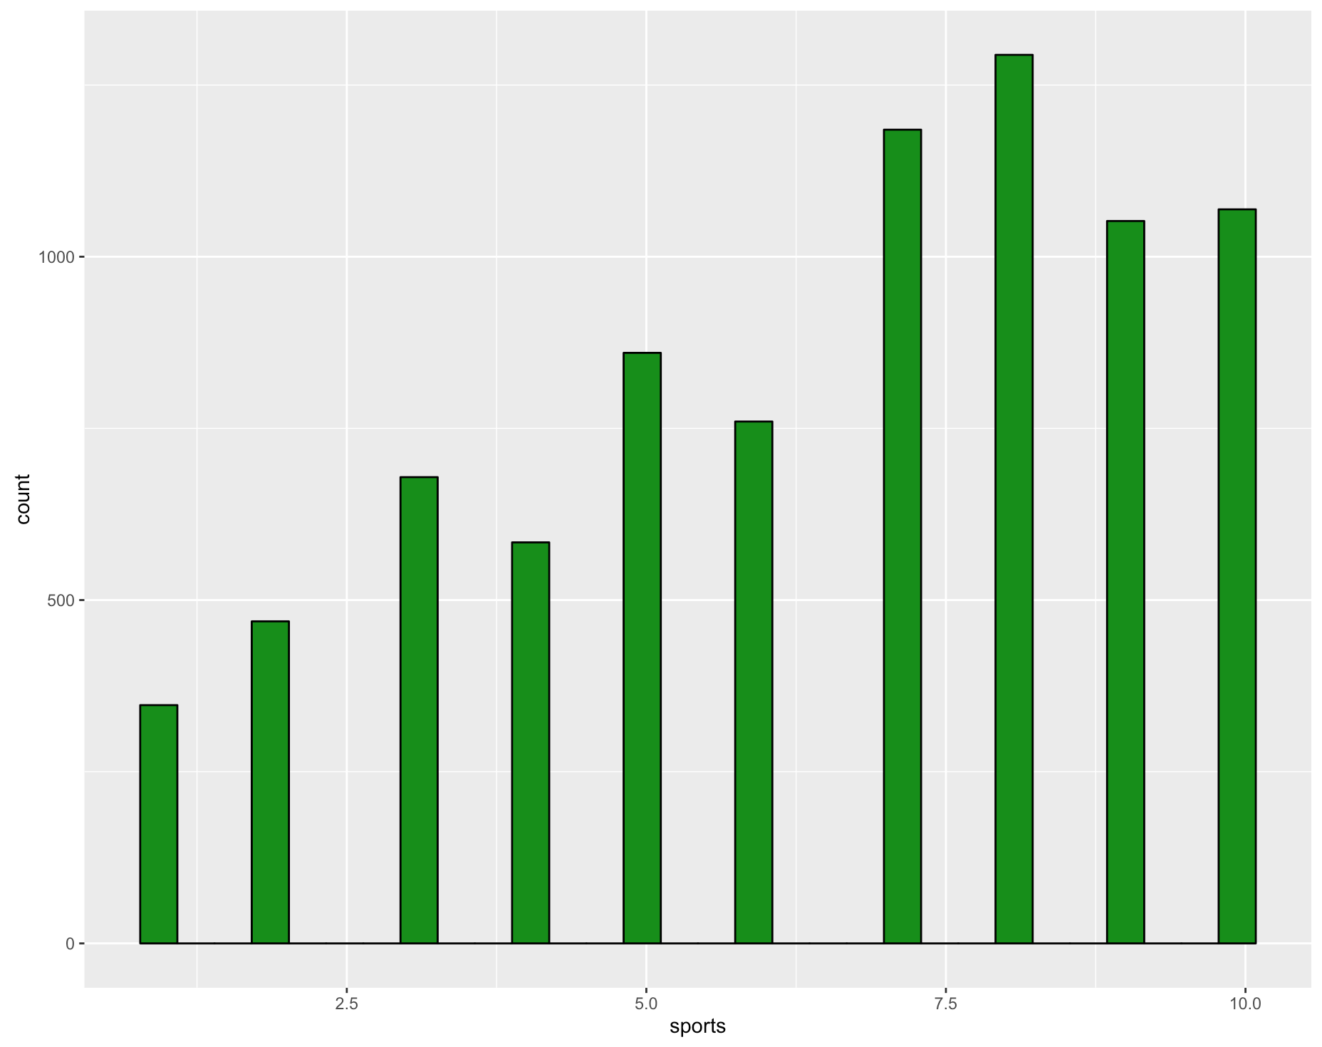
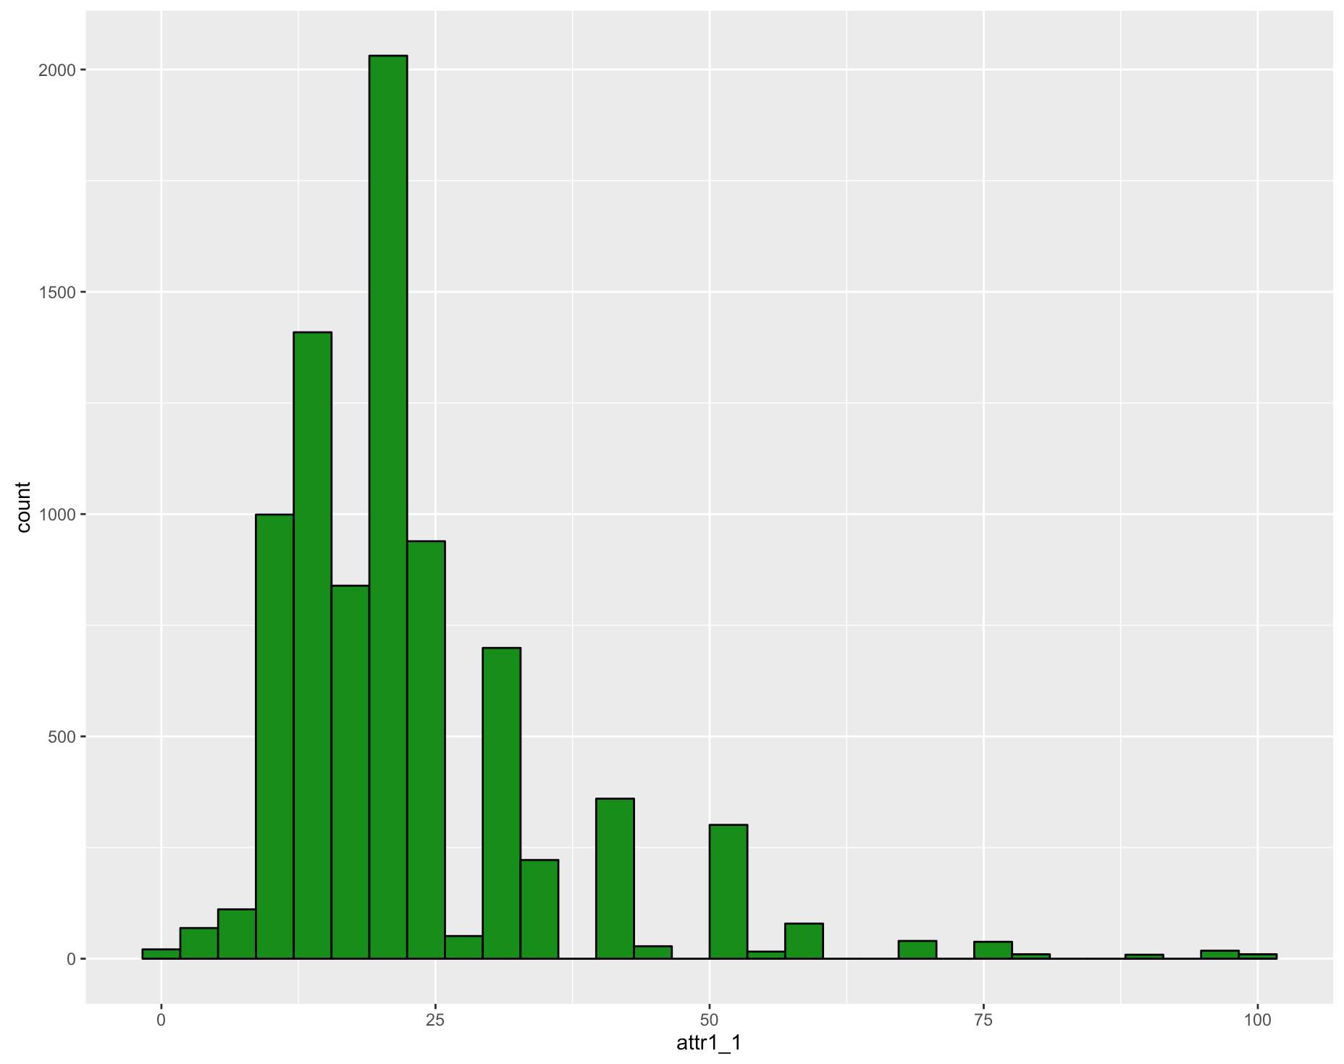
EDA - Input Variables
Demographics: gender, age of participant, age of partner, race of participant, race of partner
Initial Correlation between interests
How frequently the participants goes out, on dates & generally.
What participant is looking for: Date, Meet people, etc.
Interests: For example, sports
What the participants looks for in the opposite sex.
What the participants thinks the opposite sex looks for.
What participant thinks of themselves.

Slide 7
Analysis - Correlations
No variables are even moderately correlated with the reponse variable, “match”.
However, some variables are moderately correlated with one another:
For example, if someone ranks art as an interest, they are likely to also be interested in museums and theater. Same goes for music and concerts, and theater and movies.
Additionally, if someone thinks the opposite sex finds sincerity important, they are likely to believe they do not find attractiveness important in their partner.
Notes:
Perhaps some of these interests should be reduced into categories.

Slide 8
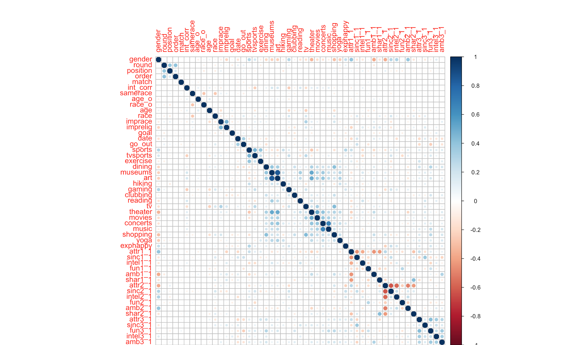
Notes:
Corrplot illustrates the correlations between some variables.

Slide 9
Modeling - Preparation
We are trying to predict whether a date will result in a “match” -- an outcome of 1 or 0.
Split data into train and test data sets.
Train is approximately 75% of the data, test is the remaining 25%.
Center and Scale data to have mean of 0 and stddev of 1
Classification Techniques Attempted:
Logistic Regression using stepwise variable selection
K Nearest Neighbor Classification
Random Forest
Support Vector Machine

Slide 10
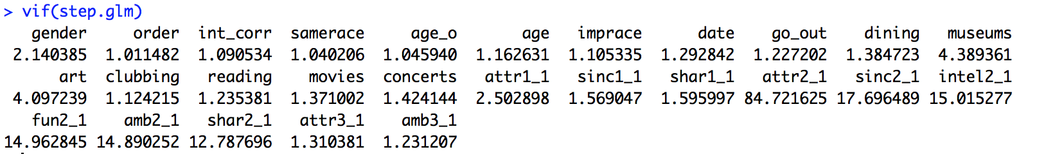
Modeling: Stepwise Logistic
A majority of the variables are removed during the stepwise variable selection process.
Additionally, observing the variance inflation factors of the remaining variables in the stepwise logistic model, all of the attributes representing what the participants believe the opposite sex thinks is important have values well above 10 and will be removed from the final model.

Slide 11
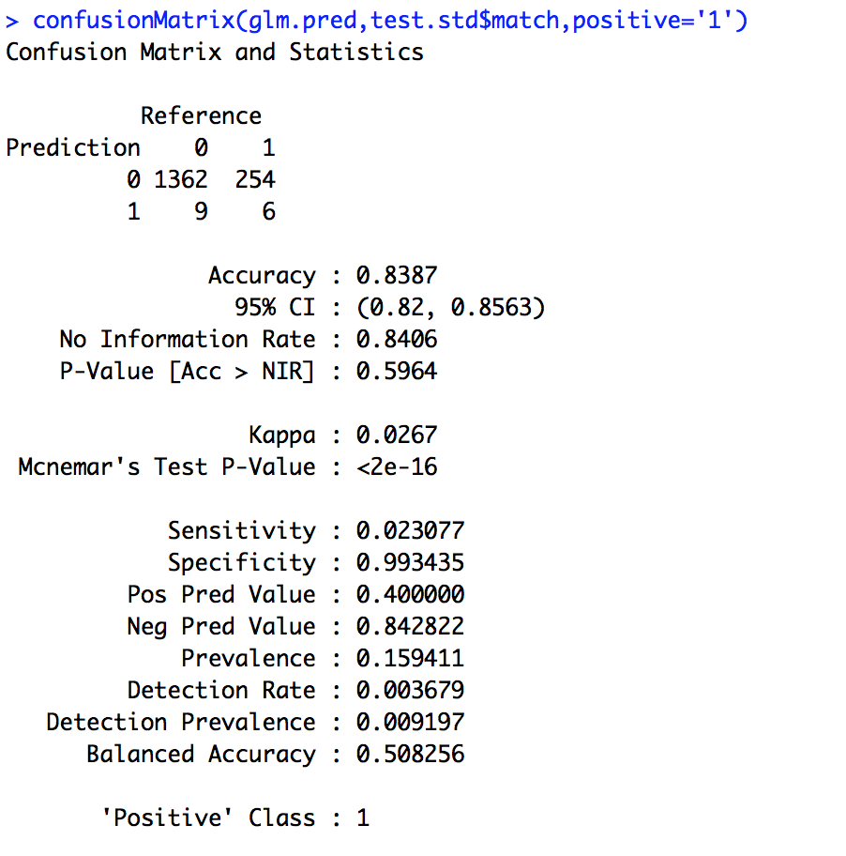
Modeling: Stepwise Logistic
Using a threshold of 0.35, an optimal accuracy can be achieved at 83.9%.
The sensitivity is AWFUL for this model.
It basically cannot seem to find any separating features to distinguish a match.

Slide 12
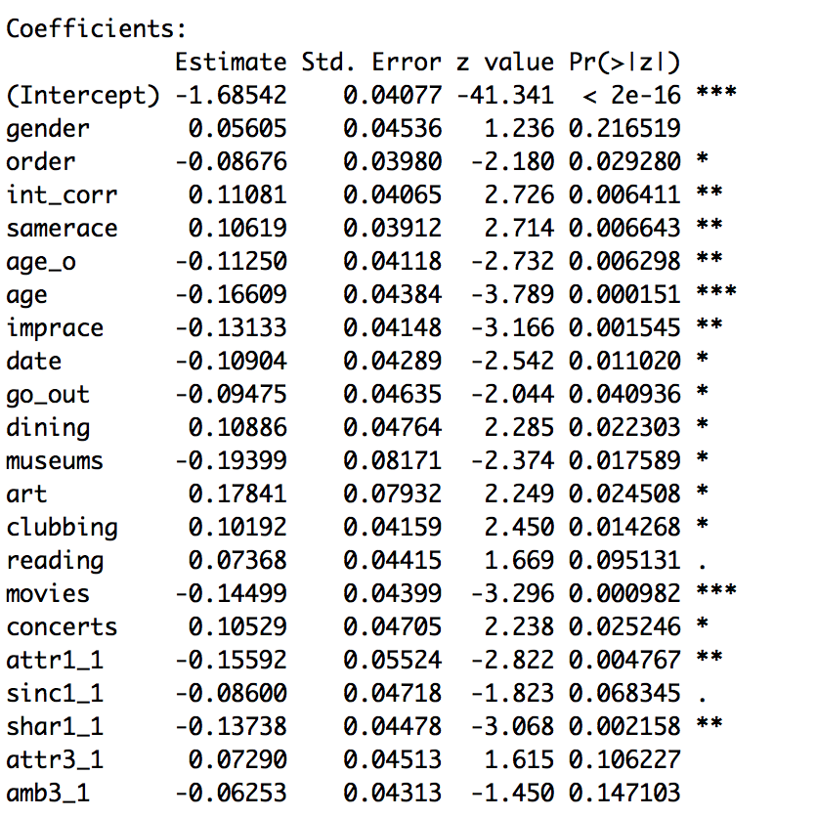
Notes:
Logistic Model coefficients

Slide 13
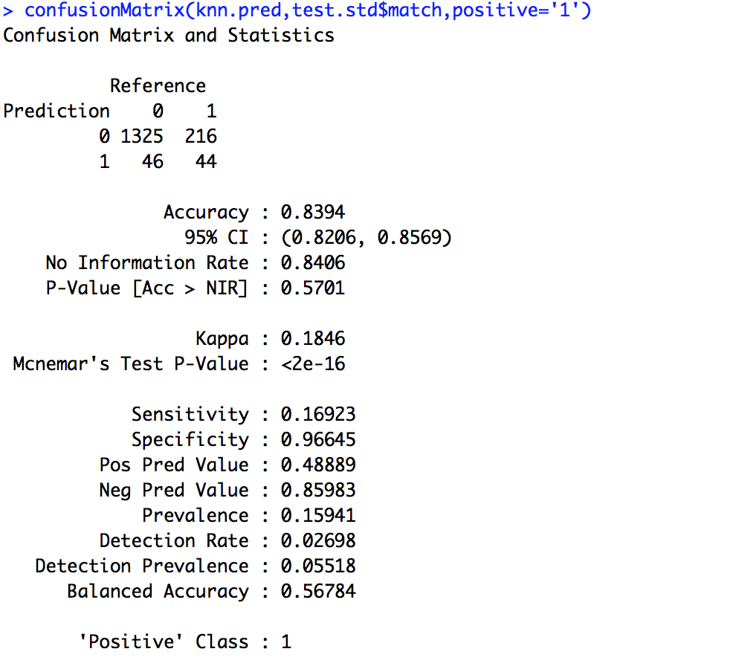
Modeling: KNN
This model performs slightly better on the test set when using k=7.
The model does really good at predicting a “no match” scenario, but is still struggling capturing the “match” scenario.
83.9% accuracy is pretty good.

Slide 14
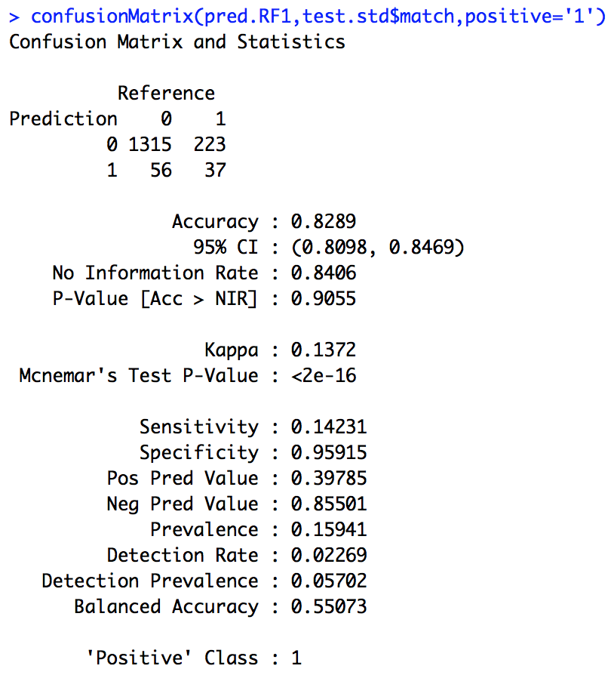
Modeling: Random Forest
This model performs slightly worse than the KNN approach at 82.9% test accuracy.
Although accuracy is less than the logistic, it does a better job of predicting a match.

Slide 15
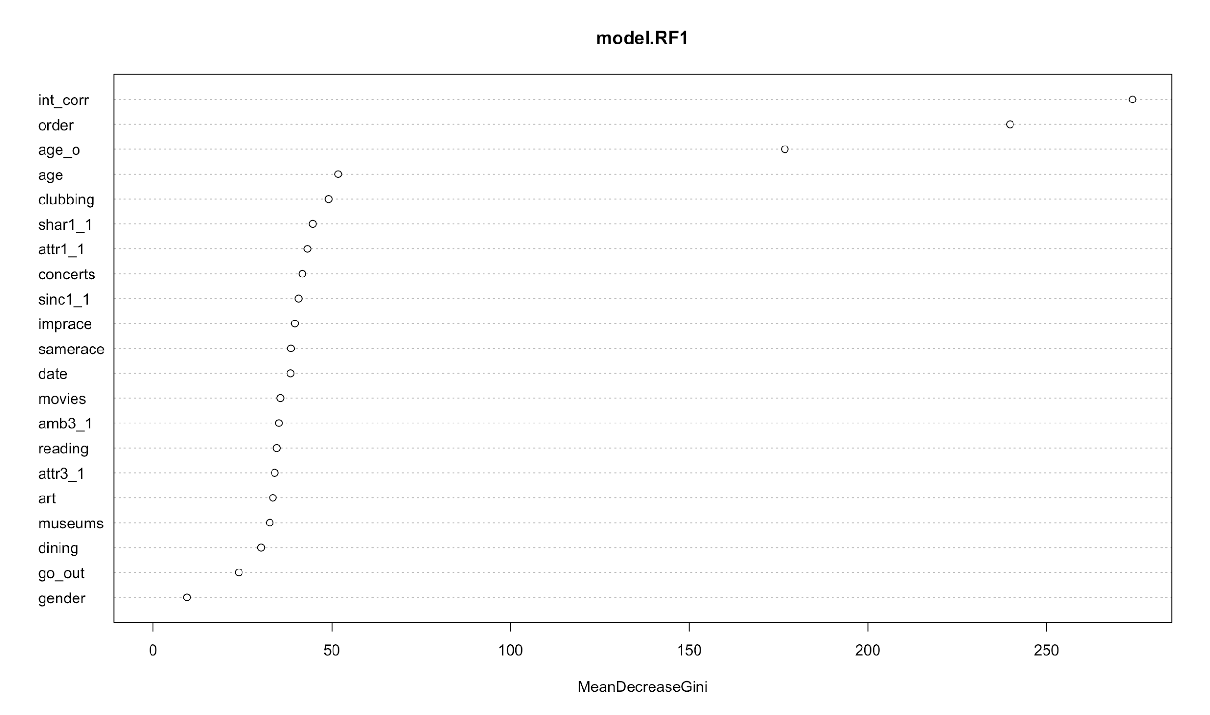
Modeling: Random Forest Variable Importance

Slide 16
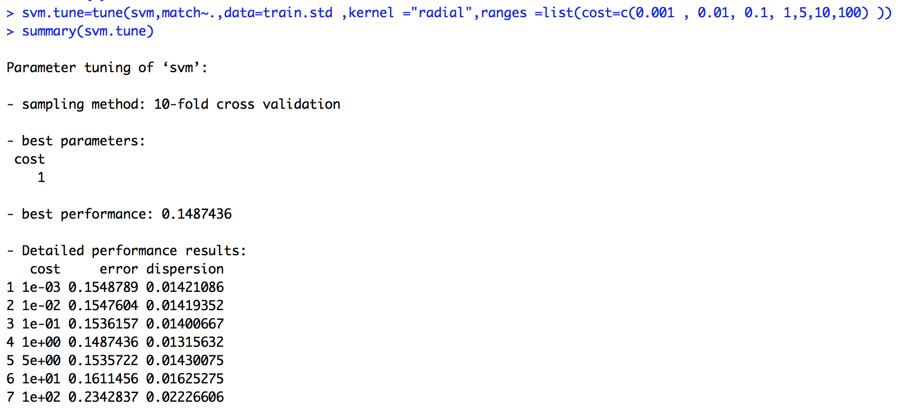
Modeling: SVM Tuning
Notes:
Chose to try a radial kernel and find the best model using tune()

Slide 17
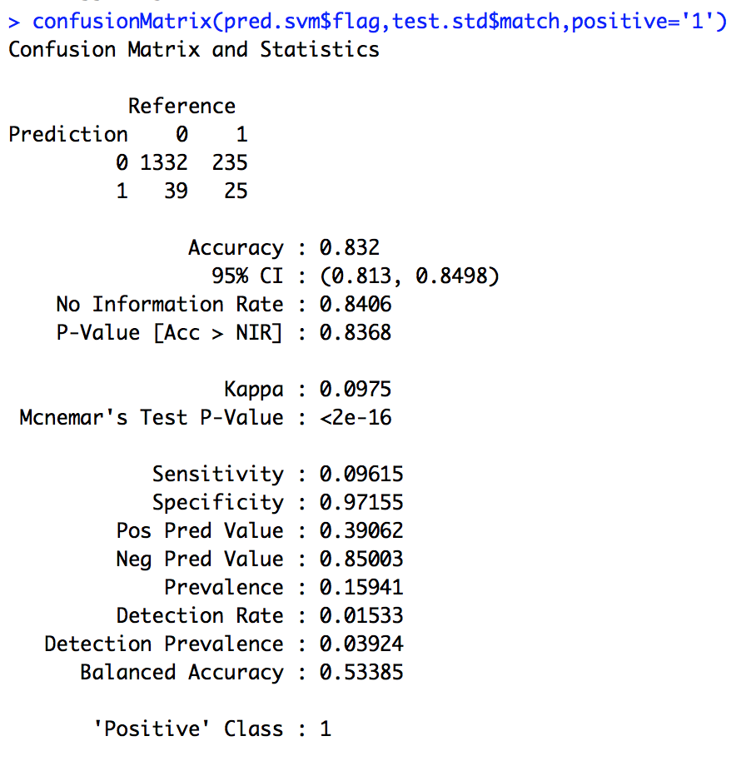
Modeling: SVM
The support vector machine is comparable in that it has an accuracy of 83.3%. However, it still is not very good at predicting our target class of “match”.
Notes:
Chose to try a radial kernel and find the best model using tune()

Slide 18
And the best model is...
Considering performance in terms of accuracy on the test set alone, one would most likely select the KNN classification model.
However, considering the interpretability of the random forest (i.e having the variable importances to look back on), one might decide to sacrifice a little bit of accuracy for the insight into what lead an observation to be classified the way that it was.

Slide 19
Reflection/Summary/Conclusion
The best model for accuracy isn’t always the most interpretable one.
For support vector machines, it is helpful to leverage R’s parallel processing capabilities to speed things up.
When the data is so heavily skewed towards one class, it throws a wrench into an otherwise classic classification problem.
Although Gender was speculated as being a variable that impacts whether or not someone gets a match or not, it isn’t very important in the random forest and it’s not significant at all in the logistic regression.
Doing this again, we would work on grouping the interests into components representing the category of interest.

Slide 20
Code
Full project code can be found here: https://github.com/amsheets/PREDICT422_GroupECProject

